Slide 1
What is Parallel Processing?
Parallel processing is another method used to improve performance in a computer system, when a system processes two different instructions simultaneously, it is performing parallel processing

Slide 2
Topics Include
Parallelism in Uniprocessor Systems
Parallelism in Multiprocessor Systems
  Flynn’s Classification
  System Topologies
  MIMD System Architectures

Slide 3
Parallelism in Uniprocessor Systems
A uniprocessor (one CPU) system can perform two or more tasks simultaneously. The tasks are not related to each other. So, a system that processes two different instructions simultaneouly could be condsidered to perform parallel processing

Slide 4
Example of Uniprocessor System
Recall in Chapter 11, the instruction pipeline is similar to a manufacturing assembly line. If the assembly line is partitioned into four stages: The first stage receives some parts, performs its assembly task, and passes the results to the second stage; the second stage takes the partially assembled product from the first stage, performs its task, and passes its work to the third stage; the third stage does its work, passing the results to the last stage, which completes the task and outputs its results. As the first piece moves from the first stage to the second stage, a new set of parts for a new piece enters the first stage. Ultimately, every staged processes a piece simultaneously. This is how time is saved and this is an example of parallelism in uniprocessor

Slide 5
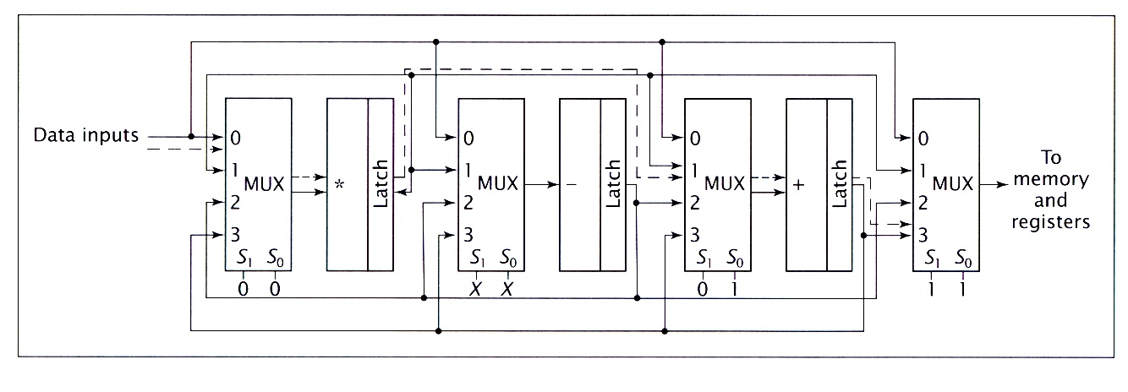
Reconfigurable pipeline
Another example of parallelism in a uniprocessor system. In a reconfigure arithmetic pipeline, each stage has a multiplexer at its input. The multiplexer may pass input data, or the data output from other stages, to the stage inputs.

Slide 6
Vector Arithmetic unit
Vector Arithmetic unit is used to perform different arithmetic operations in parallel. A vector arithmetic unit contains multiple functional units. Some perform addition, others subtraction, and others perform different functions.

Slide 7
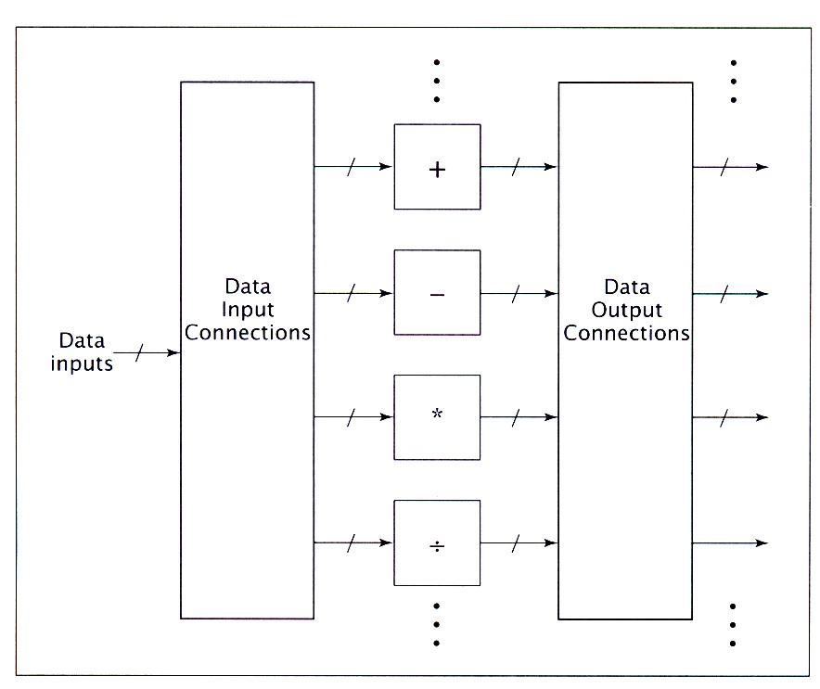
A Vectored Arithmetic unit
To add two numbers, the control unit routes these values to an adder unit. For the operations A B + C, and D E - F the CPU would route B and C to an adder and send E and F to a subtracter, this allows the CPU to execute both instructions simultaneouly.

Slide 8
Parallelism in Multiprocessor Systems
Parallel processing systems achieve parallelism by having more than one processor performing tasks simultaneously. Since multiprocessor systems are more complicated than uniprocessor systems, there are many different ways to organize the processors and memory, so a researcher, Michael J. Flynn proposed a classification based on the flow of instructions and data within the computer called Flynn’s classification

Slide 9
Flynn’s Classification
It is based on instruction and data processing. A computer is classified by whether it processes a single instruction at a time or multiple instructions simultaneously, and whether it operates on one or multiple data sets.

Slide 10
Categories of Flynn’s Classification
SISD: Single instruction with single data
SIMD: Single instruction with multiple data
MISD: Multiple instruction with single data
MIMD: Multiple instruction with multiple data

Slide 11
Single Instruction Single Data
(SISD)
SISD machines executes a single instruction on individual data values using a single processor. Even if the processor incorporates internal parallelism, such as an instruction pipeline, the computer would still be classified as SISD

Slide 12
(SIMD) Single Instruction Multiple Data
As its name implies, an SIMD machine executes a single instruction on multiple data values simultaneously using many processors. Since there is only one instruction, each processor does not have to fetch and decode each instruction. Instead a single control unit handles this task for all processors within the SIMD computer

Slide 13
(MISD) Multiple Instruction Single Data
This classification is not practical to implement. So, no significant MISD computers have ever been built. It is included for completeness of the classification.

Slide 14
(MIMD) Multiple Instruction Multiple Data
Systems referred to as multiprocessors or multicomputers are usually MIMD. It may execute multiple instructions simultaneously, unlike SIMD. So, each processor must include its own control unit. MIMD machines are well suited for general purpose use.

Slide 15
System Topologies
The topology of a multiprocessor system refers to the pattern of connections between its processors. Various factors, typically involving a cost-performance tradeoff, determine which topology a computer designer will select for a multiprocessor system.

Slide 16
Topology
Although topologies differ greatly, standard metrics-diameter and bandwidth-are used to quantify them
Diameter- the maximum distance between two processors in the computer system.
Bandwidth- the capacity of a communications link multiplied by the number of such links in the system.
Bisection bandwidth-represents the maximum data transfer that could occur at the bottleneck in the topology.

Slide 17
Examples of Topology (pattern of connections between processors)
Shared Bus Topology
Ring Topology
Tree Topology
Mesh Topology
Hypercube Topology
Completely connected Topology

Slide 18
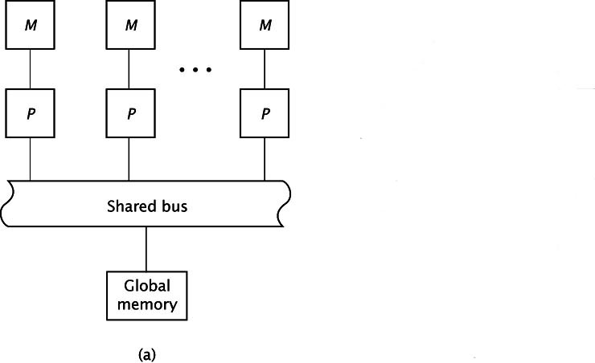
Shared Bus Topology
In this topology, processors communicate with each other exclusively through this bus. However, the bus can only handle only one data transmission at a time. In most shared busses, processors directly communicate with their own local memory.

Slide 19
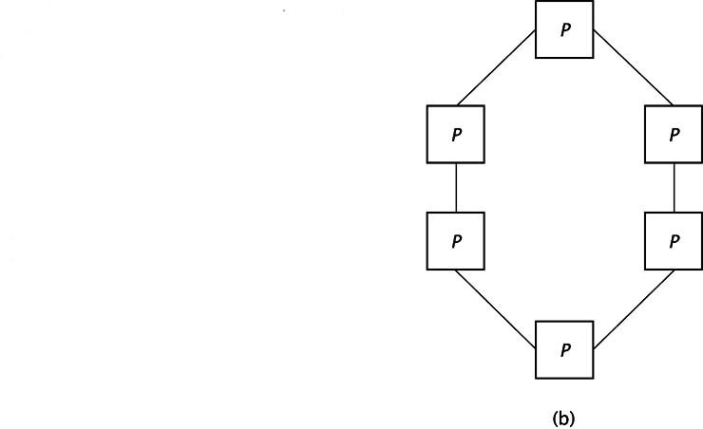
Ring Topology
The ring topology uses direct connections between processors instead of a shared bus. This allows all communication links to be active simultaneously. Data may have to travel through several processors to reach its destination

Slide 20
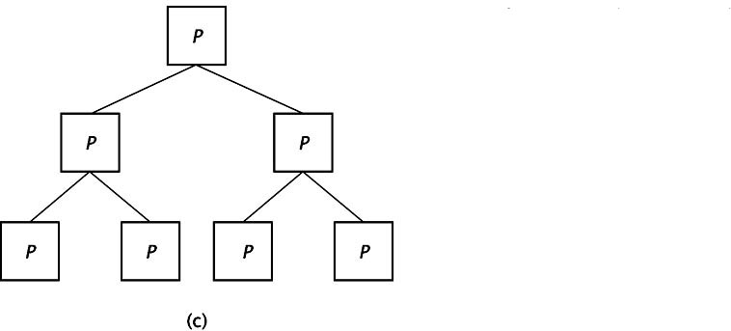
Tree Topology
Like the ring, it uses direct connections between processors; each having three connections. There is only one unique path between any pair of processors

Slide 21
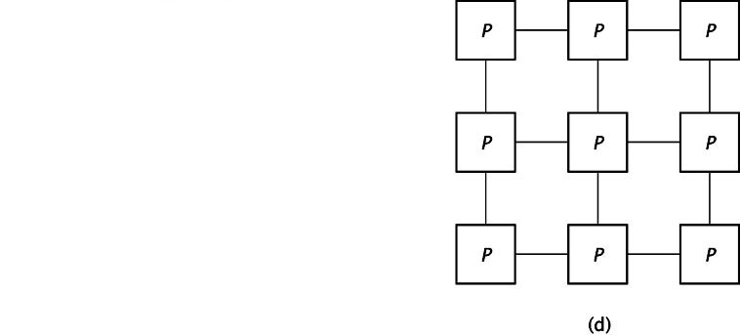
Mesh Topology
In the mesh topology, every processor connects to the processors above and below it, and to its right and left.

Slide 22
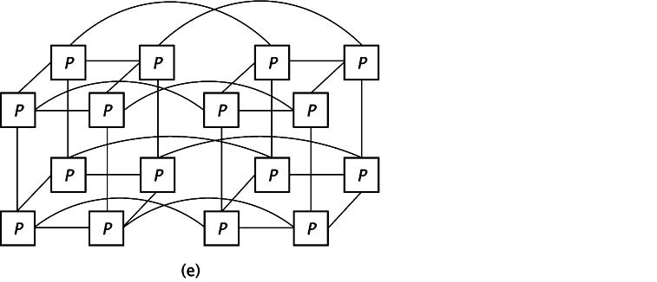
Hypercube Topology
The hypercube is a multidimensional mesh topology. Each processor connects to all other processors whose binary values differ by one bit.

Slide 23
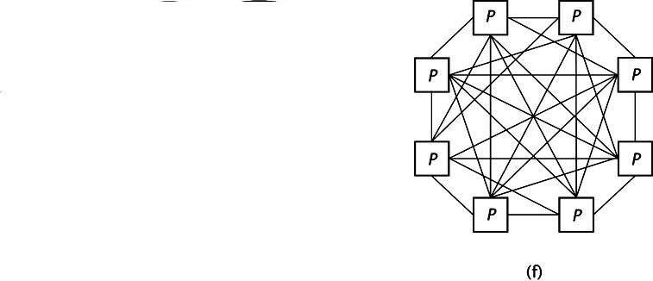
Completely connected Topology
In the most extreme connection scheme, the processors are completely connected. Every processor has (n-1) connections, one to each of the other processors. This increases the complexity of the processors as the system grows, but offers maximum communication capabilities.

Slide 24
MIMD System Architectures
The architecture of an MIMD system, as opposed to its topology, refers to its connections with respect to system memory. There are two types of architectures:
Uniform memory access(UMA)
Nonuniform memory access(NUMA)

Slide 25
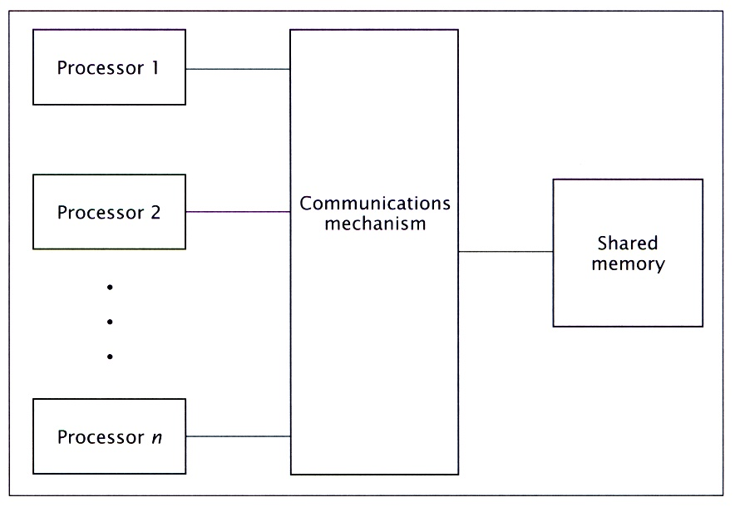
(UMA) Uniform Memory Access
The UMA gives all CPUs equal (uniform) access to all locations in shared memory. They interact with shared memory by some communications mechanism like a simple bus or a complex multistage interconnection network

Slide 26
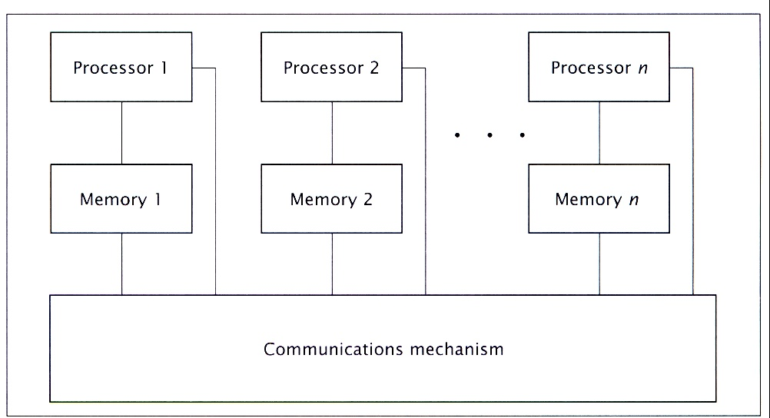
(NUMA) Nonuniform memory access
In contrast to UMA architectures, NUMA do not allow uniform access to all shared memory locations, this architecture still allows all processors to access all shared memory locations. However, each processor can access the memory module closest to it, its local shared memory, more quickly than the other modules, so the memory access times are nonuniform.

Slide 27
The End

